Slide 1
MS
MeeSeva | Transport · Telangana
MeeSeva
Driving Licence
Portal
Digitizing Government Transport Services for Citizens of Telangana
Team Members
Sai Lasya Grandhi 2520030538 | Bathula Neha 2520090013
25CS1201E | Front End Development Frameworks & UI Engineering | 2025-26 Term-III

Slide 2
Introduction
Slide 2
❌ The Problem
✅ Our Solution
Manual, Paper-Based Processes
Long queues at RTO offices
Limited transparency & tracking
Complex eligibility checks
Delays in coordination between applicants and authorities
Difficulty booking test slots
Single digital platform for all DL services
Online application & eligibility check
Slot booking & test scheduling
Mock fee payment system
Real-time status tracking & notifications
Certificate PDF download
→
Tech Stack: React.js · Node.js · Express.js · REST APIs · MySQL · Axios · React Router · Bootstrap / Tailwind CSS

Slide 3
Abstract
Slide 3
This project digitizes key transport services under the Meeseva (government) domain — applying for a learner's licence, scheduling driving tests, issuing original driving licences, and handling renewals. Current processes involve multiple manual steps, long queues, limited transparency, and delays between applicants and authorities.
📋
🚗
Learner's Licence
Driving Test Scheduling
The proposed solution is a beginner-friendly web application that streamlines the entire workflow into a single digital platform. Users can fill application forms, auto-check eligibility, schedule tests, and book available slots through an intuitive interface. A mock fee payment system, real-time status tracking, notifications, and certificate PDF download are included.
🪪
💳
On the backend, REST APIs built with Node.js and Express.js handle data processing and communication, while React.js ensures a responsive and dynamic frontend. Optional MySQL integration provides persistent storage. An admin panel manages applications and exports data for reporting. The system improves efficiency, reduces manual errors, and demonstrates how modern web technologies can simplify essential government services.
DL Issuance & Renewal
Mock Fee Payment
📍
📄
Real-time Status Tracking
Certificate PDF Download
Guide: Shiva Krishna | Course: 25CS1201E — Front End Development Frameworks & UI Engineering | 2025-26 Term-III

Slide 4
Course Outcomes (COs) Included
Slide 4
CO1
Foundations & Framework Design
CO2
JS/TS Engineering
Component-like HTML blocks for each module (Dashboard, Eligibility, Application, etc.)
CSS custom properties (:root variables) mirror design-token philosophy of modern frameworks
Sidebar navigation & stat cards reflect component thinking (ProductList / ProductCard equivalent)
Pure utility functions: runEligibility(), processPayment(), exportExcel(), initAdminTable()
ADMIN_DATA array acts as a typed data model (equivalent to interface Product)
Immutable .map() and .join() transformations for CSV export — pure-function principles
CO3
React Component Model
CO4
State Architecture & API
Reusable UI patterns: .btn, .card, .badge, .stat-card, .form-group — composable building blocks
CSS Grid & Flexbox for responsive layouts (grid-template-columns: repeat(4,1fr))
@keyframes animations and CSS utility-class styling equivalent to Tailwind / Bootstrap
nav() routing function manages active-page state across 10+ modules — like React Context Provider
Mock payment, slot booking, and admin table simulate full REST API interactions
Abstract specifies Node.js + Express.js REST APIs, Axios, React Context/Redux for real implementation
CO5
Routing, Forms & Performance
CO6
Build Systems & CI/CD
SPA-style nav() hides/shows sections without page reloads — mirrors React Router pattern
5-step controlled form pipeline: appNext(), appBack(), updateSteps() with validation stages
Responsive @media queries, keyboard-navigable UI, and Blob-based lazy PDF/CSV generation (A11y)
Postman used for API testing; backend module includes Node.js + Express.js + MySQL integration
Admin panel with data export (CSV/PDF) and reporting — production-readiness mindset
Clear frontend/backend separation suitable for Vercel (frontend) + Node server (backend) deployment
Course: 25CS1201E — Front End Development Frameworks & UI Engineering | All 6 COs addressed in this project

Slide 5
Code Overview
Slide 5
meeseva-login.html — Login Page
meeseva-portal.html — Main Portal
:root {
--navy: #0a1628;
--saffron: #FF6B00;
--green: #138808;
}
.wrapper {
display: grid;
grid-template-columns: 1fr 480px;
}
/* Tricolor stripe */
.tricolor-saffron { background:#FF6B00; }
.tricolor-white { background:#FFFFFF; }
.tricolor-green { background:#138808; }
// Login validation
function doLogin() {
const mob = mobileFld.value.trim();
const pwd = passFld.value;
if (mob.length < 10 || pwd.length < 6) {
showError('Check credentials');
return;
}
showSuccess('Login successful!');
redirect('portal');
}
// Navigation router
function nav(page) {
document.querySelectorAll('.page')
.forEach(p=>p.classList.remove('active'));
document.getElementById('page-'+page)
.classList.add('active');
}
// Eligibility checker
function checkEligibility() {
const age = getAge(dobInput.value);
const type = licenceType.value;
if (type === 'LL-LMV' && age < 18) {
showResult('Ineligible','Min age 18 yrs');
} else { showResult('Eligible','✓ Proceed'); }
}
// Admin export to CSV
function exportExcel() {
const csv = ADMIN_DATA
.map(r=>[r.id,r.name,r.status].join(','))
.join('\n');
downloadBlob(csv, 'Applications.csv');
}
Frontend · React.js + HTML5 + CSS3
Backend · Node.js + Express.js + REST APIs

Slide 6
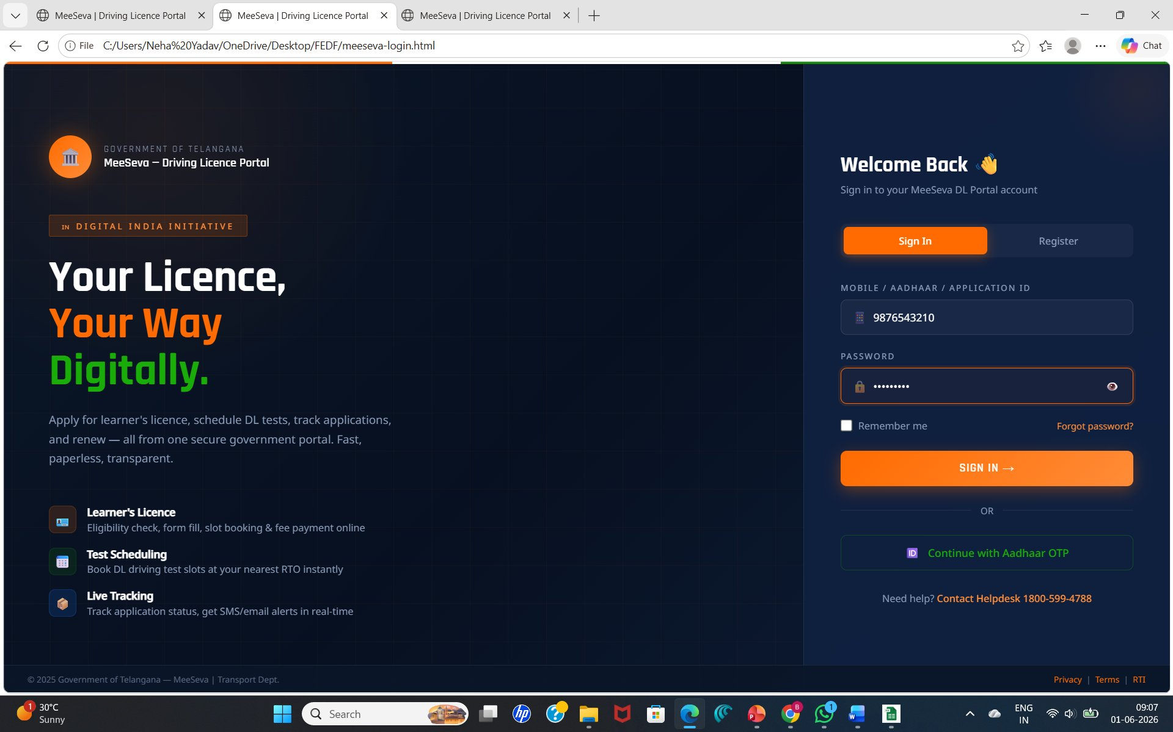
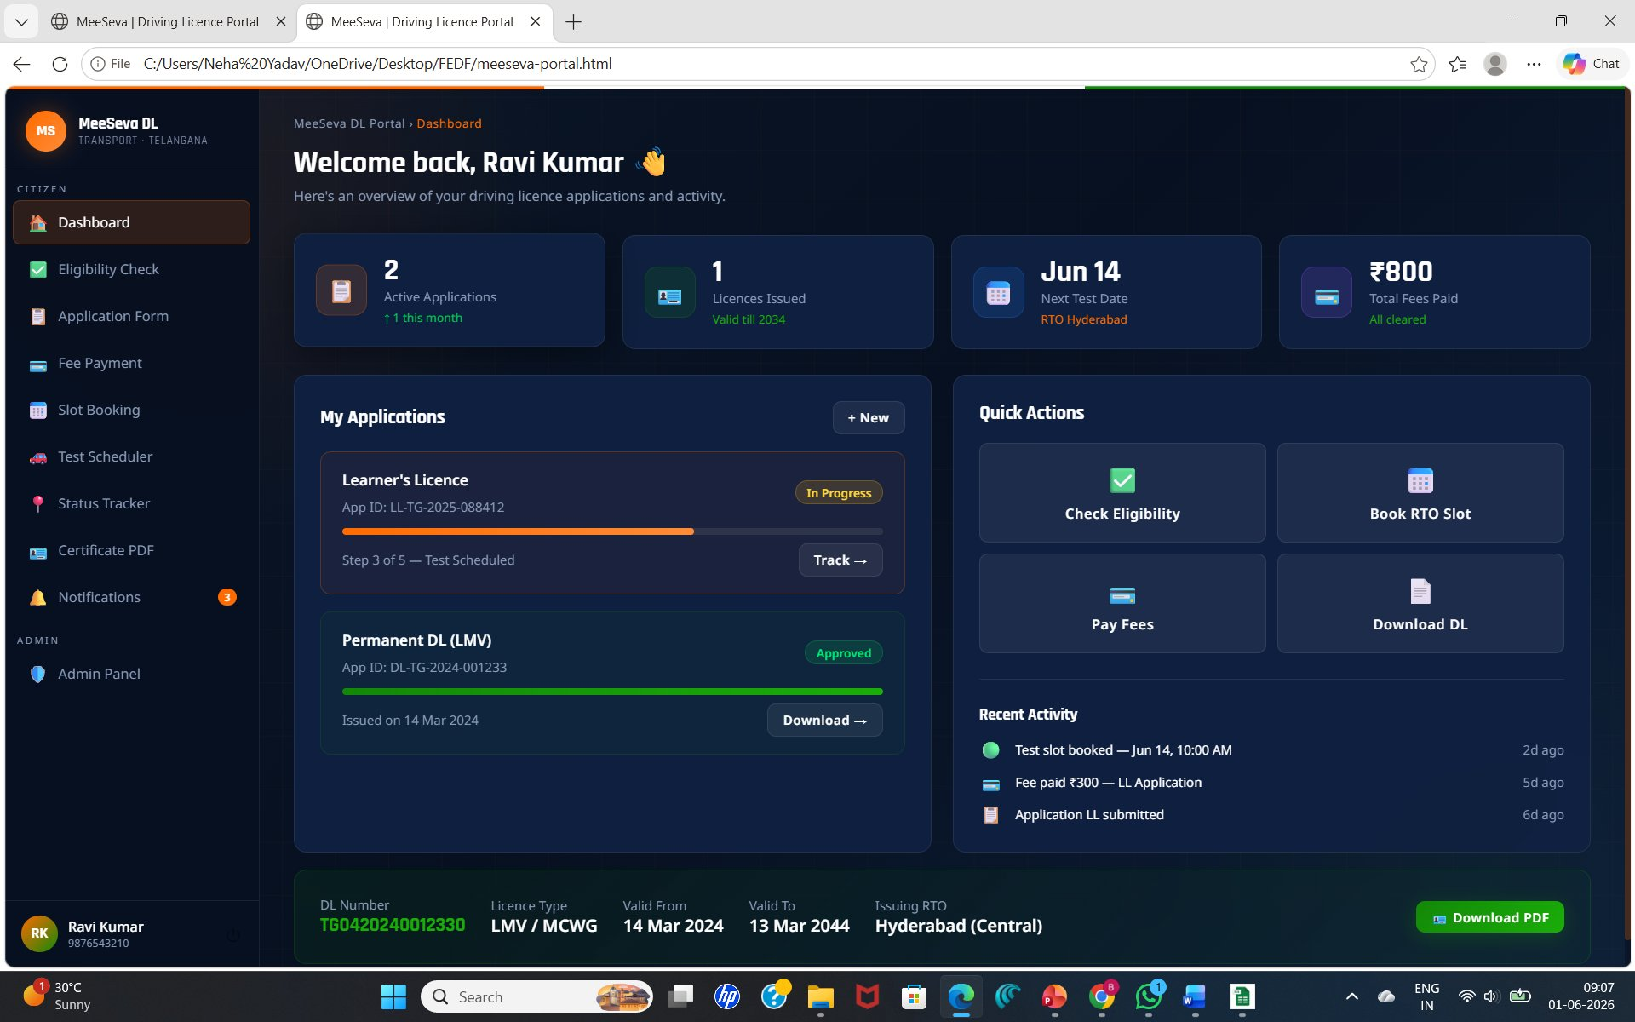
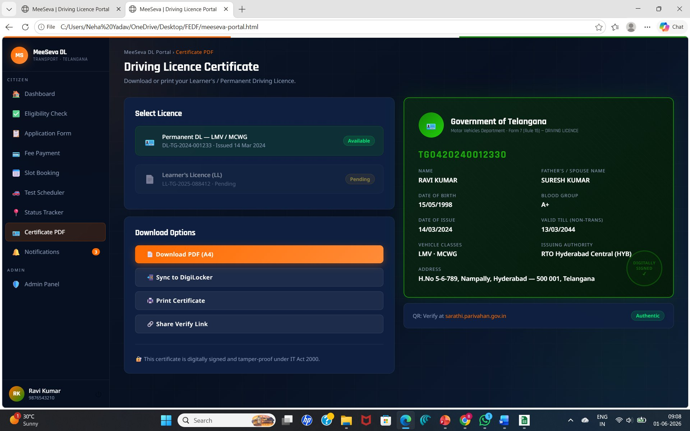
Output / Screenshots
Slide 6
🔐 Login Page
📋 Dashboard
🪪 Certificate PDF
Tricolor-themed login with mobile/Aadhaar auth, Sign In / Register tabs, Aadhaar OTP option, and helpdesk contact.
Stats: 2 Active Apps, 1 Licence (valid till 2034), Next Test Jun 14 at RTO Hyderabad, ₹800 fees paid. Quick Actions & Recent Activity.
Permanent DL (LMV/MCWG) — TG0420240012330 issued by RTO Hyderabad Central. Download PDF, DigiLocker sync, Print & Share options.
Built with React.js · Node.js · Express.js · REST APIs · HTML5 · CSS3 · MySQL | Tested on Chrome · Responsive Design

Slide 7
Conclusion
⚡
Efficiency
🎯
Accuracy
Eliminates manual paperwork and long queues at RTO offices through a streamlined digital workflow.
Automated eligibility checks and form validation reduce manual errors and ensure correct submissions.
👤
User Convenience
🏛️
Gov-Tech Impact
Citizens can apply, pay, schedule tests, track status, and download certificates from one platform.
Demonstrates how modern web technologies (React, Node, REST APIs) can modernize essential government services.
The MeeSeva Driving Licence Portal proves that citizen-centric digital transformation of government services is achievable, scalable, and impactful.

Slide 8
Thank You
MeeSeva Driving Licence Portal
SL
Sai Lasya Grandhi
BN
Bathula Neha
Roll No: 2520030538
Roll No: 2520090013
Frontend Developer
React.js, UI, API Integration
Backend Developer
Node.js, Express.js, MySQL, REST APIs
Guide: Shiva Krishna | Course: 25CS1201E — Front End Development Frameworks & UI Engineering

